Slide 1
Assignment 3 From Stack to Queue
Gerald A Washington II

Slide 2
The Purpose of the Assignment
Sometimes, certain programming languages won’t be able to utilize a Queue functionality, but will be able to utilize a Stack functionality. Therefore, it is necessary to understand the difference between the two and what to do in case of this happening…

Slide 3
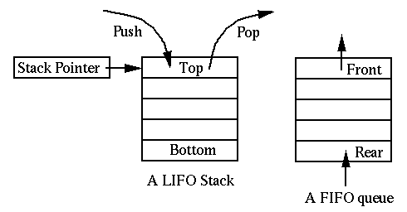
First off…
Stacks are LIFO (Last In, First Out) data structures.
Queues are FIFO (First In, First Out) data structures.

Slide 4
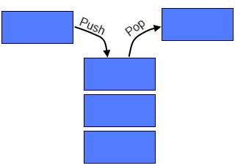
It’s Quite Simple Really…
Just use two stacks!!
Input
Flip…
Output
1,2,3
3,2,1
1,2,3
3
1
2
2
1
3

Slide 5
My only issue with this method…
If a user suddenly needed to add an element to the second stack, they would either:
Need a third stack to hold the second’s elements for proper placement of the first’s new element to Pop() back into the second. (Complicated)
Pop everything in the second stack back into the first, in order to add the new element, then Pop() the first stack into the second once more. (move backwards, then forwards)

